Slide 1
Under the Investment Grant-Aid Scheme for Private & Community SMEs there are five project categories that will be considered for funding: Category 1 – Development or Enhancement of Sustainable Visitor Experiences Category 2 – Development of Sustainable Tourist Accommodation Category 3 – Capital Project Planning & Design Category 4 – Digital Transformation Category 5 – Accessibility enhancements to provide a more inclusive visitor experience.
The first step in the Application Process is to submit an Expression of Interest (EOI) form via Fáilte Ireland's Trade Portal. The purpose of this step is to allow Fáilte Ireland to determine if the project and the applicant are eligible for this Investment Grant Scheme. If you do not have a Fáilte Ireland Trade Portal account, you will be prompted to create one. Anyone intending to register their interest in this scheme is asked to first read the Application Guidelines for the scheme. They are also available on the Fáilte Ireland website. https://www.failteireland.ie/Identify-Available-Funding/Just-Transition-Fund/investment-grant-aid-scheme.aspx
There is a FAQ section on this link also which Fáilte Ireland are constantly updating.
Below is a summary of the EOI’s to be submitted. All online on the Fáilte Ireland website.

Slide 2
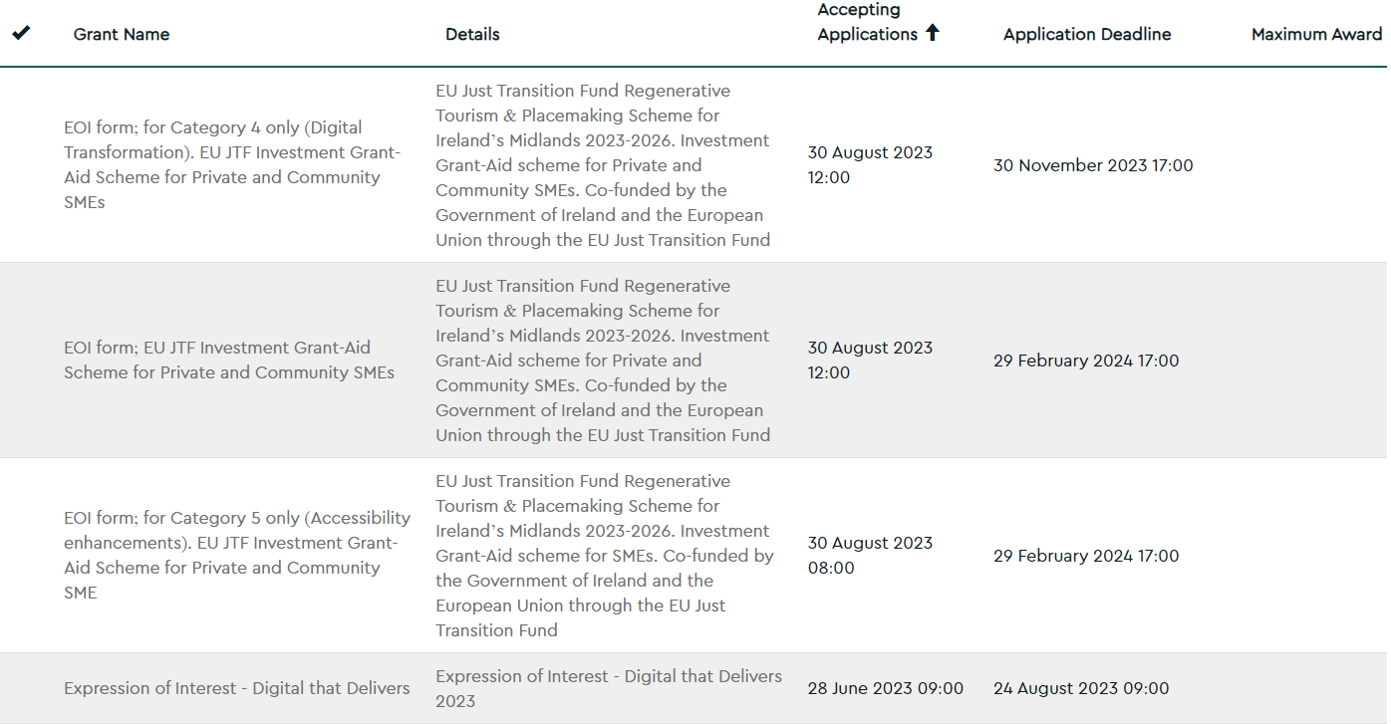
All Categories 1,2,3,4,5

Slide 4
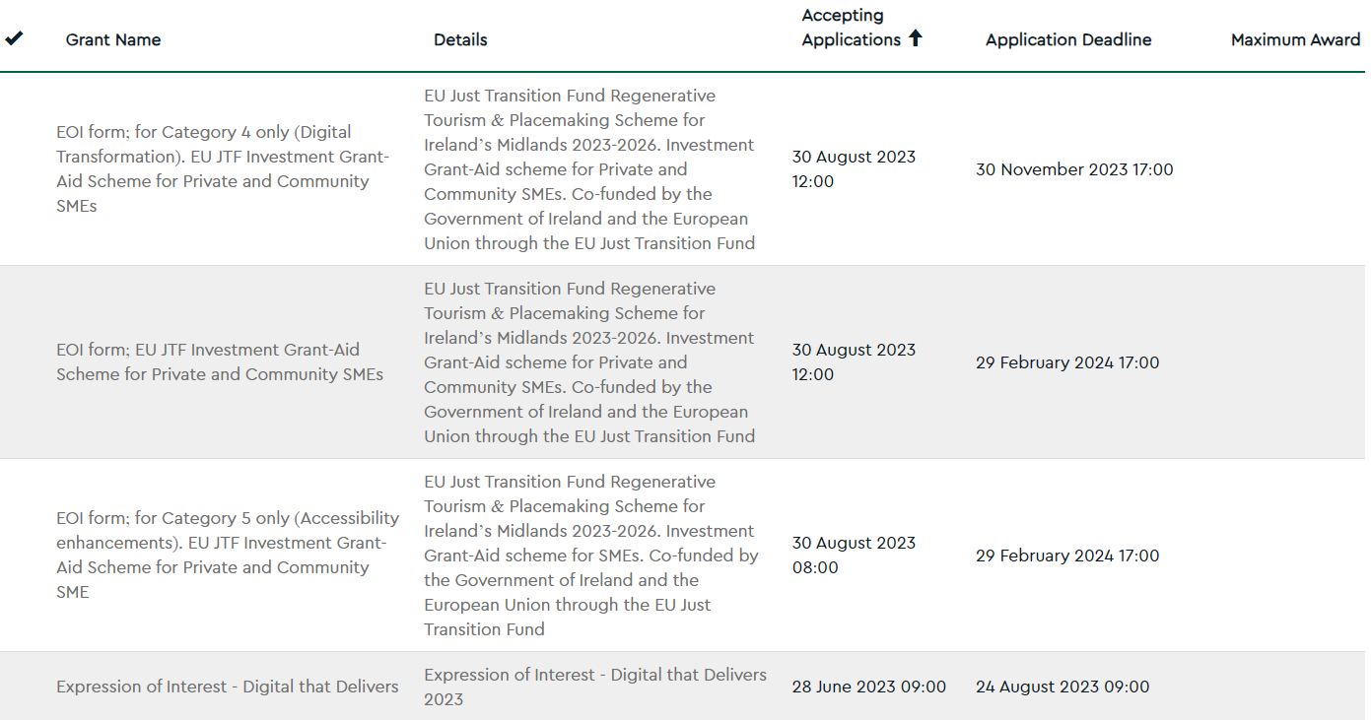

Slide 6
